Slide 1
CS97: Introduction to Data Science
05: Logistic Regression
Instructor: Shichang Zhang
shichang@ucla.edu

Slide 2

It’s OK that you do not know many things

Slide 3


Don’t lose your big picture
https://en.wikipedia.org/wiki/Fractal

Slide 4
You are taking a college-level (upper-division*) computer science class!
Be proud of yourself to have the courage to do so!

Slide 5
So far…
We learned how to predict numerical response variable (also known as target variable)
Using linear regression and its variants
We learned how to evaluate and select models
We learned a model is a trade-off between bias and variance
We learned how to add regularization to avoid overfitting

Slide 6
Next
Move from numerical prediction to classification

Slide 7
Content
Classification: Categorical Response Variable
Binary Response and Simple Logistic Regression
Multiple Logistic Regression
Classification Boundaries
Multiple Responses and Multiclass Logistic Regression

Slide 8
Advertising Data (from earlier lectures)
X
predictors
features
covariates
Y
outcome
response variable
dependent variable
TV | radio | newspaper | sales
230.1 | 37.8 | 69.2 | 22.1
44.5 | 39.3 | 45.1 | 10.4
17.2 | 45.9 | 69.3 | 9.3
151.5 | 41.3 | 58.5 | 18.5
180.8 | 10.8 | 58.4 | 12.9
n observations
p predictors

Slide 9
Heart Data
response variable Y
is Yes/No
Age | Sex | ChestPain | RestBP | Chol | Fbs | RestECG | MaxHR | ExAng | Oldpeak | Slope | Ca | Thal | AHD
63 | 1 | typical | 145 | 233 | 1 | 2 | 150 | 0 | 2.3 | 3 | 0.0 | fixed | No
67 | 1 | asymptomatic | 160 | 286 | 0 | 2 | 108 | 1 | 1.5 | 2 | 3.0 | normal | Yes
67 | 1 | asymptomatic | 120 | 229 | 0 | 2 | 129 | 1 | 2.6 | 2 | 2.0 | reversable | Yes
37 | 1 | nonanginal | 130 | 250 | 0 | 0 | 187 | 0 | 3.5 | 3 | 0.0 | normal | No
41 | 0 | nontypical | 130 | 204 | 0 | 2 | 172 | 0 | 1.4 | 1 | 0.0 | normal | No

Slide 10
Heart Data
These data contain a binary outcome HD for 303 patients who presented with chest pain. An outcome value of:
Yes indicates the presence of heart disease based on an angiographic test,
No means no heart disease.
There are 13 predictors including:
Age
Sex (0 for women, 1 for men)
Chol (a cholesterol measurement),
MaxHR
RestBP
and other heart and lung function measurements.

Slide 11
Classification
Up to this point, the methods we have seen have centered around modeling and the prediction of a quantitative response variable. Linear regression (and Ridge, LASSO, etc) perform well under these situations
When the response variable is categorical, then the problem is no longer called a regression problem but is instead labeled as a classification problem.
The goal is to attempt to classify each observation into a category (aka, class) defined by Y, based on a set of predictor variables X.

Slide 12
Typical Classification Examples
The motivating examples for this lecture(s) are based [mostly] on medical data sets. Classification problems are common in this domain:
Trying to determine where to set the cut-off for some diagnostic test (pregnancy tests, prostate or breast cancer screening tests, etc...)
Trying to determine if cancer has gone into remission based on treatment and various other indicators
Trying to classify patients into types or classes of disease based on various genomic markers

Slide 13
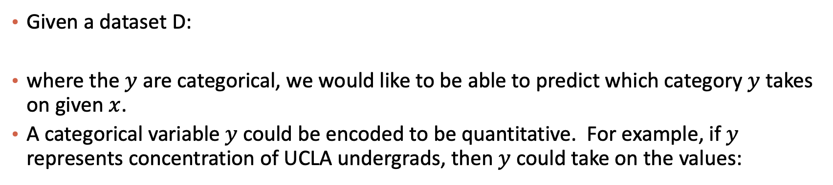
A Classification Example
Given a dataset D:
where the $y$ are categorical, we would like to be able to predict which category $y$ takes on given $x$.
A categorical variable $y$could be encoded to be quantitative. For example, if $y$ represents concentration of UCLA undergrads, then $y$ could take on the values:
Linear regression does not work well, or is not appropriate at all, in this setting.

Slide 14
A Classification Example (cont.)
A linear regression could be used to predict y from x. What would be wrong with such a model?
The model would imply a specific ordering of the outcome, and would treat a one-unit change in y equivalent. The jump from y = 1 to y = 2 (CS to Statistics) should not be interpreted as the same as a jump from y = 2 to y = 3 (Statistics to everyone else).
Similarly, the response variable could be reordered such that y = 1 represents Statistics and y = 2 represents CS, and then the model estimates and predictions would be fundamentally different.
If the categorical response variable was ordinal (had a natural ordering, like class year, Freshman, Sophomore, etc.), then a linear regression model would make some sense but is still not ideal.

Slide 15
Even Simpler Classification Problem: Binary Response
The simplest form of classification is when the response variable $y$has only two categories, and then an ordering of the categories is natural.
$y=\left\{\begin{aligned}1, if disease=yes \\ 0, if disease=no \end{aligned}\right.$
Linear regression could be used to predict $y$ directly from a set of predictors (like age, gender, lab results, etc.), and if $\hat{y}≥0.5,$ we could predict the person has the disease and predict no disease if $\hat{y}<0.5$.

Slide 16
What Would be a Strategy for binary classification?
$y=\left\{\begin{aligned}1, if disease=yes \\ 0, if disease=no \end{aligned}\right.$
What if we want to use a probabilistic model?
Recall that probability is frequency of events occurring
Given a group of people, how do we define the probability of having disease?

Slide 17
Probability vs. Conditional Probability
Let’s see what it means

Slide 18



Please download and install the Slido app on all computers you use
What is your most frequently used social media?
ⓘ Start presenting to display the poll results on this slide.

Slide 19
Please download and install the Slido app on all computers you use
If you are from abroad (non-U.S. countries), answer the same question again. What is your most frequently used social media?
ⓘ Start presenting to display the poll results on this slide.

Slide 20
Please download and install the Slido app on all computers you use
If you are from U.S., answer the same question again. What is your most frequently used social media?
ⓘ Start presenting to display the poll results on this slide.

Slide 21
What have we learned just now?
Probability
P(Y)
Conditional probability
P(Y|X=“abroad”)
P(Y|X=“U.S.”)
Yes, we don’t need a stats course to understand this

Slide 22
Probabilistic interpretation
For the binary classification task
Consider two classes, labeled as 1 and 0
Model probability of two outcomes
$P(y=1|x)$ and $P(y=0|x)$
Each in the range of [0,1] and $P\left(y=0 | x\right)=1−P(y=1|x)$
Therefore, only need to model $P(y=1|x)$
If $P\left(y=1 | x\right)>0.5,$ classify it into class 1; otherwise, class 0

Slide 23
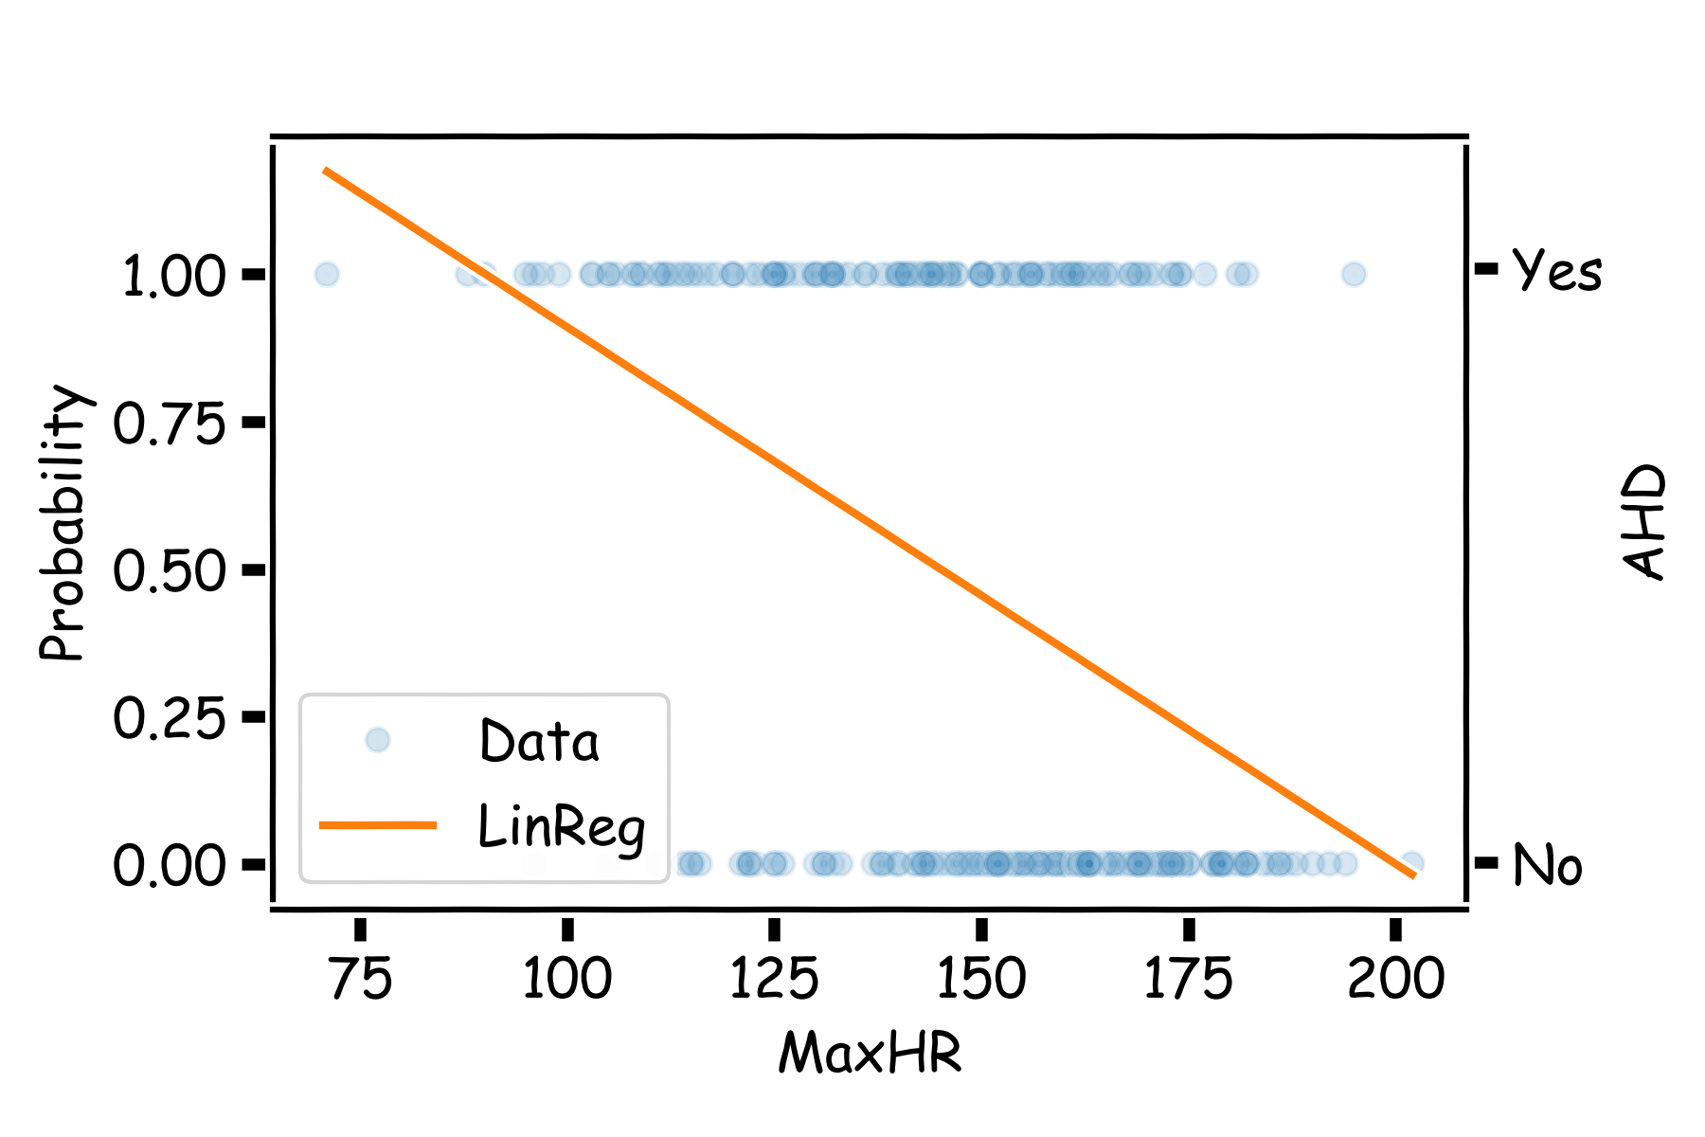
Even Simpler Classification Problem: Binary Response (cont)
What could go wrong with this linear regression model?

Slide 24
Linear Regression for Binary Classification
Can we just use linear regression to predict a binary classification task?
Look at the range / target of linear regression
Think about the probabilistic interpretation of binary classification

Slide 25
Even Simpler Classification Problem: Binary Response (cont)
The main issue is you could get undefined values for $y.$ Since this is modeling $P(y=1)$, values for $\hat{y}$ below 0 and above 1 would be at odds with the natural measure for $y.$Linear regression can lead to this issue.
Key takeaway: in Machine Learning and Data Science, as with all quantitative disciplines, first think about your model’s input and output, then decide whether to use them

Slide 26

Please download and install the Slido app on all computers you use
Audience Q&A Session
ⓘ Start presenting to display the audience questions on this slide.

Slide 27
Content
Classification: Categorical Response Variable
Binary Response and Simple Logistic Regression
Multiple Logistic Regression
Classification Boundaries
Multiple Responses and Multiclass Logistic Regression

Slide 28
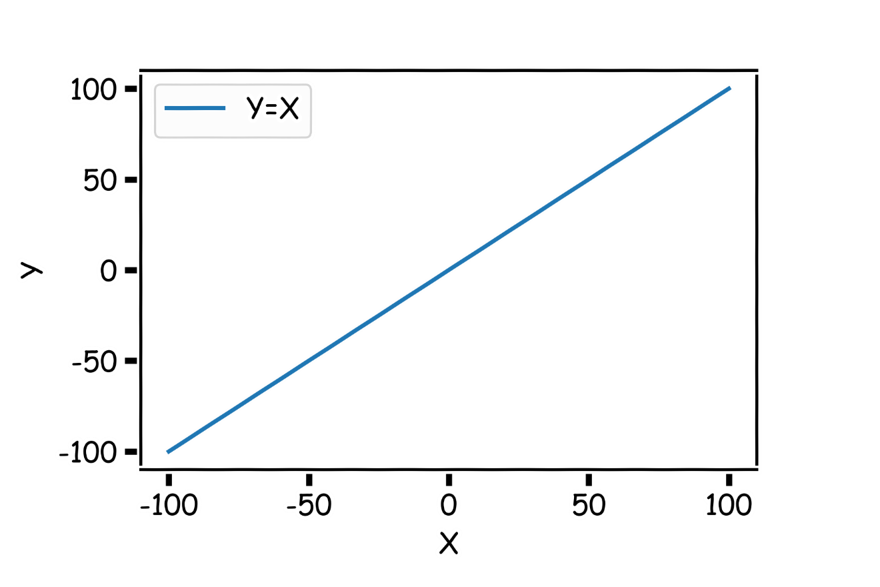
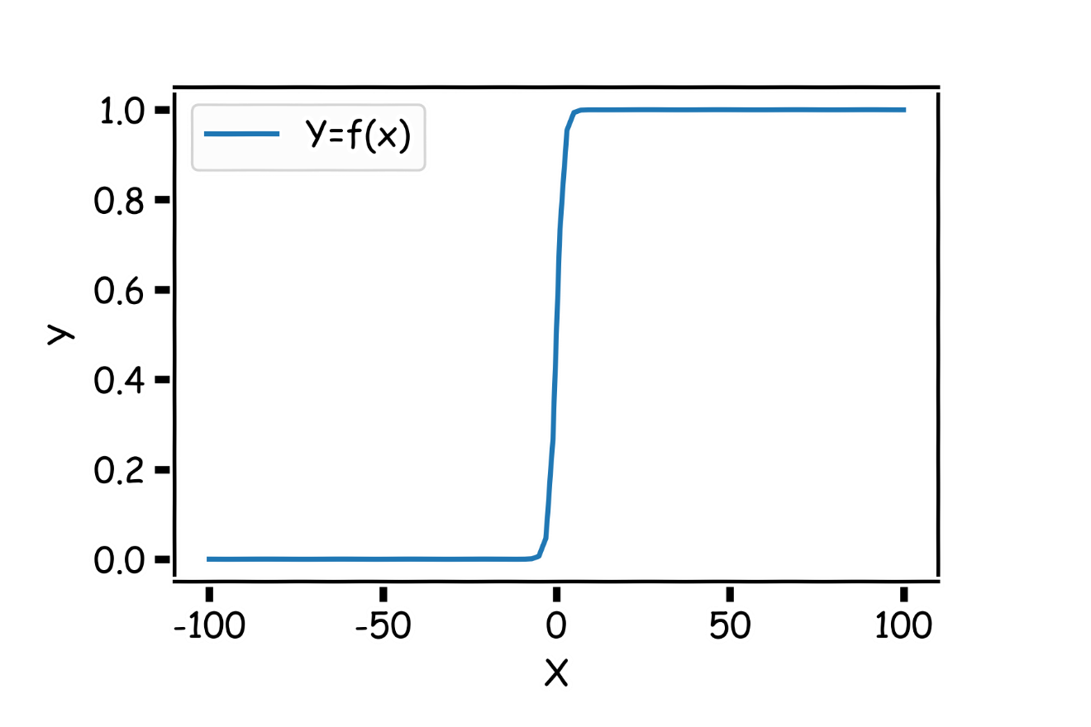
Logistic Function
Think of a function that would do this for us
$$Y=f(x)$$

Slide 29
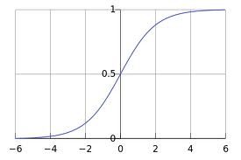
Logistic Function
Logistic Function / sigmoid function: $σ\left(x\right)=\frac{1}{1+e^{−x}}$
Note: not standard deviation
$$Note:σ^{′}\left(x\right)=σ(x)(1−σ(x))$$
Notes:
Discussion session. Derivation

Slide 30
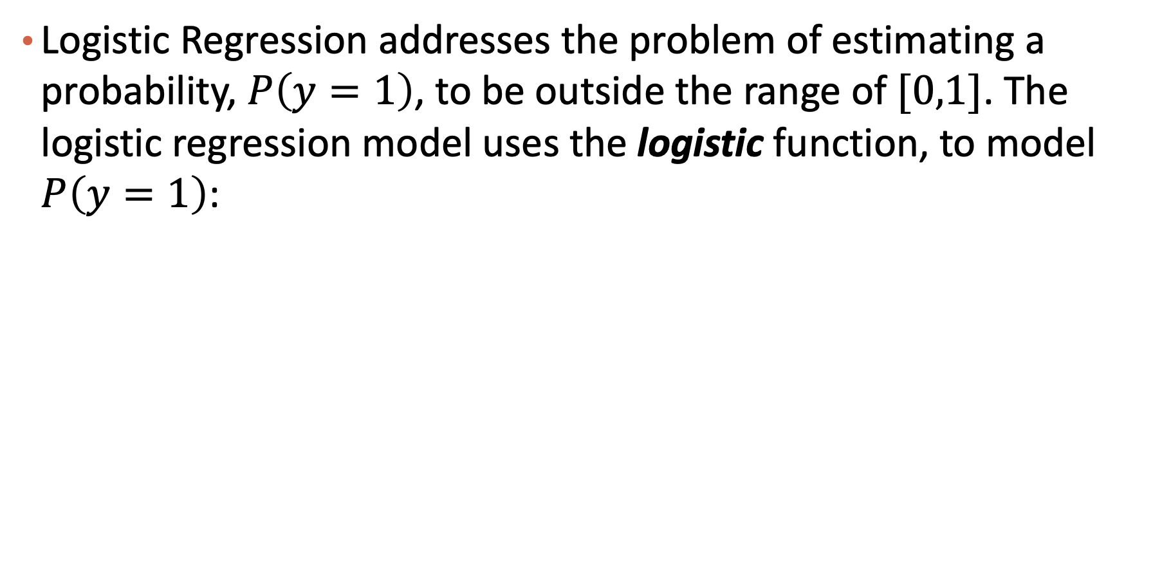
Logistic Regression
Logistic Regression addresses the problem of estimating a probability, $P\left(y=1\right)$, to be outside the range of $[0,1]$. The logistic regression model uses the logistic function, to model $P\left(y=1\right)$:
$$P\left(Y=1\right)=σ\left(β_{0}+β_{1}X\right)=\frac{1}{1+e^{−(β_{0}+β_{1}X)}}$$
In machine learning, this is often known as “linear regression with logistic activation”

Slide 31
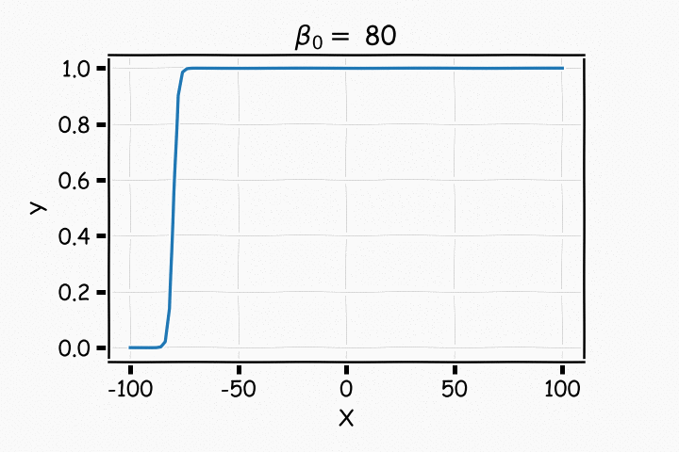
Understanding $β_{0}$

Slide 32
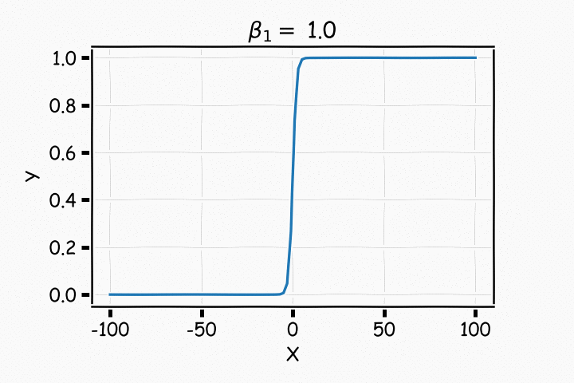
Understanding $β_{1}$

Slide 33
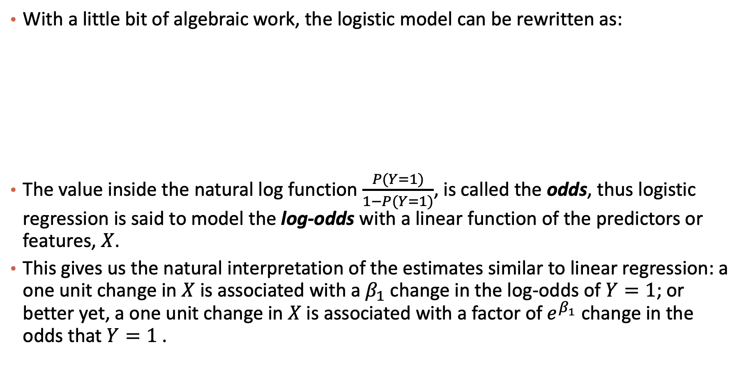

Logistic Regression
With a little bit of algebraic work, the logistic model can be rewritten as:
The value inside the natural log function $\frac{P(Y=1)}{1−P(Y=1)}$, is called the odds, thus logistic regression is said to model the log-odds with a linear function of the predictors or features, $X$.
This gives us the natural interpretation of the estimates similar to linear regression: a one unit change in $X$ is associated with a $β_{1}$ change in the log-odds of $Y=1$; or better yet, a one unit change in $X$is associated with a factor of $e^{β_{1}}$ change in the odds that $Y=1$.
Recall:$P\left(Y=1\right)=\frac{1}{1+e^{−(β_{0}+β_{1}X)}}$
Notes:
means that increasing {\displaystyle x_{1}} by 1 increases the log-odds by {\displaystyle 1}. So if {\displaystyle x_{1}} increases by 1, the odds that {\displaystyle Y=1} increase by a factor of {\displaystyle 10^{1}}. Note that the probability of {\displaystyle Y=1} has also increased, but it has not increased by as much as the odds have increased.

Slide 34
Exercises
Question: For the odds defined as $\frac{P(Y=1)}{1−P(Y=1)}$, what’s the range of it?
E.g, what if P(Y=1) = 0.9, odds = 0.9/0.1=9, 0.99/0.01 = 99,
[0, +infinity)
$Question:what is the range of ln⁡(\frac{P(Y=1)}{1−P(Y=1)})$ ?
(-infinity, +infinity)
P(Y=1) = 0.5, odds = 1 ln(odds)=0

Slide 35
Please download and install the Slido app on all computers you use
Audience Q&A Session
ⓘ Start presenting to display the audience questions on this slide.

Slide 36
Estimation in Logistic Regression
Questions:
In linear regression what loss function was used to determine the parameter estimates?
Which loss function we should use for logistic regression?
Notes:
Residuals are from normal distribution

Slide 37
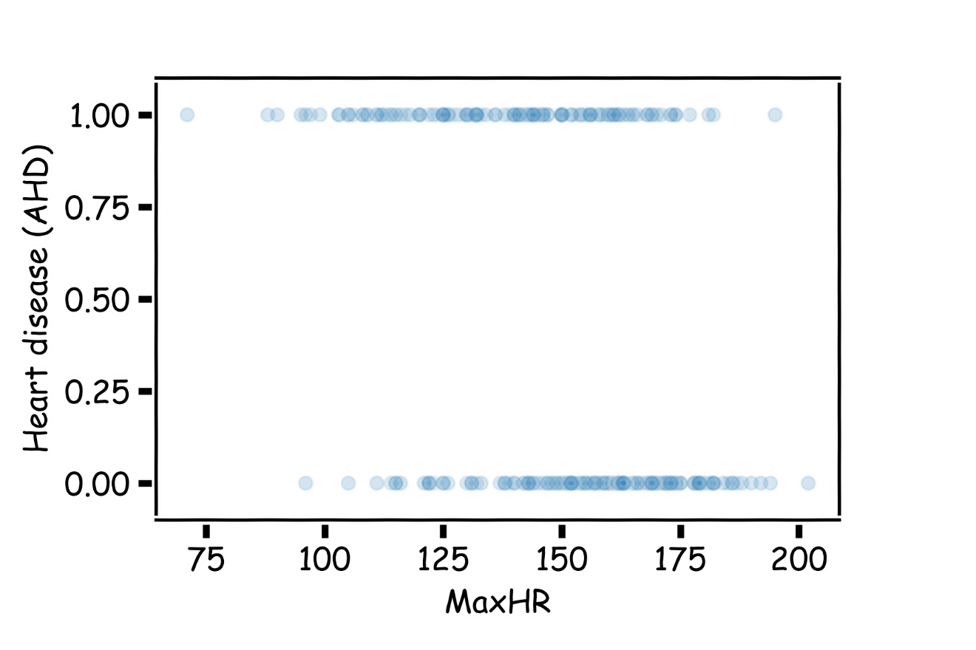
Which logistic curve is better?
Maybe this one?

Slide 38
Which logistic curve is better?
This one?

Slide 39
Which logistic curve is better?
Or this one?

Slide 40
Check this toy example: compute probabilities
Suppose we trained a logistic regression model, where $β_{0}=−1 and β_{1}=1$
Compute probabilities of their response variable taking the value 1 ($P(Y=1|X)$) for the following two data points (hint: first compute $β_{0}+β_{1}X$)
$x_{1}=1$, ${β_{0}+β_{1}x_{1}=0; p}_{1}=P\left(y_{1}=1\right)=$0.5
$x_{2}=0,$ ${β_{0}+β_{1}x_{2}=−1; p}_{2}=P\left(y_{2}=1\right)=\frac{1}{1+e}=0.269$
T/F: When X is bigger, the probability is higher?
Notes:
Answer: 0.5 and 1/(1+(e^1))=0.27

Slide 41
Which prediction is better?
Observed Y | Predicted P for Y=1
$$y_{1}=1$$ | $$p_{1}=0.8$$
$$y_{2}=1$$ | $$p_{2}=0.2$$
$$y_{3}=0$$ | $$p_{3}=0.8$$
$$y_{4}=0$$ | $$p_{4}=0.2$$
Observed Y | Predicted P for Y=1
$$y_{1}=1$$ | $$p_{1}=0.8$$
$$y_{2}=1$$ | $$p_{2}=0.8$$
$$y_{3}=0$$ | $$p_{3}=0.2$$
$$y_{4}=0$$ | $$p_{4}=0.2$$
How to quantify our intuition?

Slide 42
Independent and Likelihood
Independent
Now let’s consider tossing coins: you toss a coin, then the second, then the third, … Those outcomes will not affect each other.
Likelihood
A fancy terminology to say the probability to observe a collection of data points
Assuming those data points are generated independently, it’s the product of all the probabilities

Slide 43
Which prediction is better?
Observed Y | Predicted P for Y=1
$$y_{1}=1$$ | $$p_{1}=0.8$$
$$y_{2}=1$$ | $$p_{2}=0.2$$
$$y_{3}=0$$ | $$p_{3}=0.8$$
$$y_{4}=0$$ | $$p_{4}=0.2$$
Observed Y | Predicted P for Y=1
$$y_{1}=1$$ | $$p_{1}=0.8$$
$$y_{2}=1$$ | $$p_{2}=0.8$$
$$y_{3}=0$$ | $$p_{3}=0.2$$
$$y_{4}=0$$ | $$p_{4}=0.2$$
How to quantify our intuition?
Using likelihood of the dataset
Product of probabilities of observing each data point’s outcome label
Likelihood of left table = $p_{1}×p_{2}×\left(1−p_{3}\right)×\left(1−p_{4}\right)=0.8×0.2×0.2×0.8=0.0256$
Likelihood of right table = $p_{1}×p_{2}×\left(1−p_{3}\right)×\left(1−p_{4}\right)=0.8×0.8×0.8×0.8=0.4096$

Slide 44
The logic behind estimation
Different $β_{0}^{′}s and β_{1}^{′}s$give us different predicted probability for each data point
Based on the predicted probability (of Y = 1), we can compute the likelihood of that dataset, which is a product of probabilities of observing each data point’s outcome label
We want to find $β_{0} and β_{1}$ such that the likelihood is maximized
E.g., gradient ascent

Slide 45
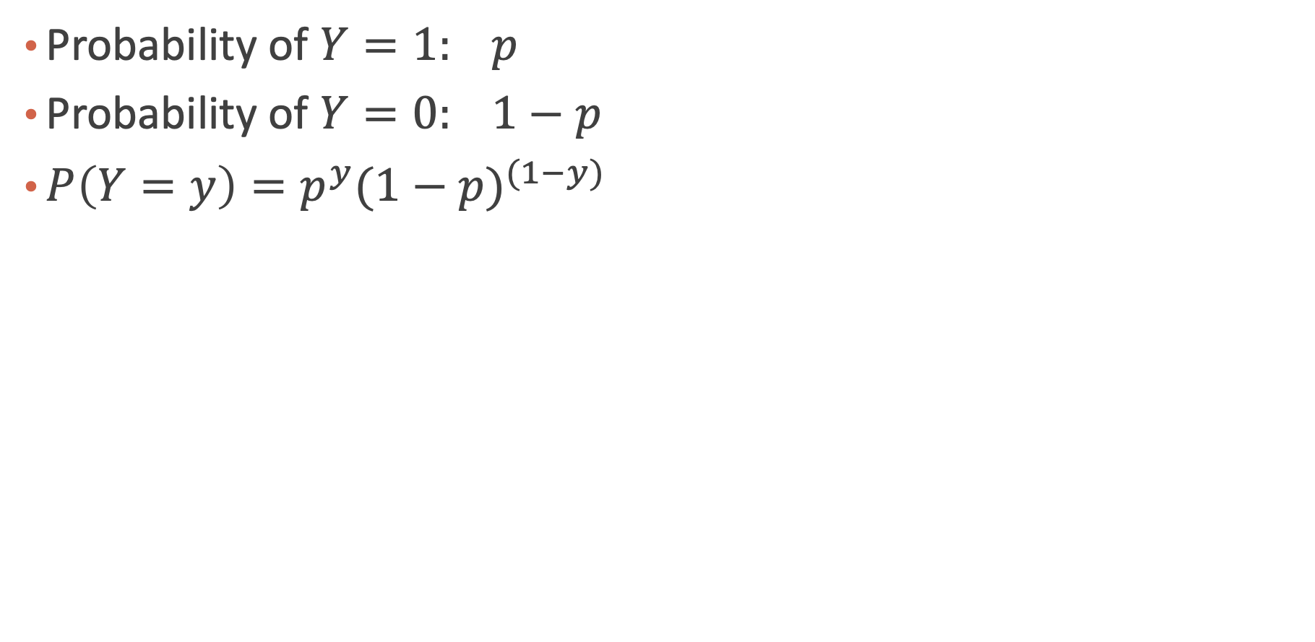
A Bernoulli Distribution
Probability of $Y=1: p$
Probability of $Y=0: 1−p$
${P\left(Y=y\right)=p}^{y}{(1−p)}^{(1−y)}$

Slide 46
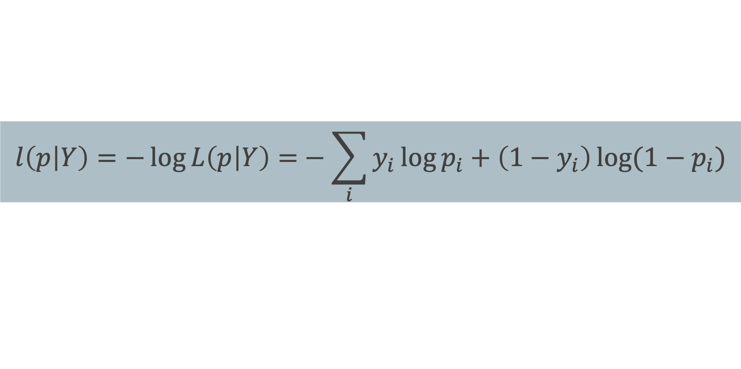
From Likelihood function to Loss function
The likelihood of a single observation for p given x and y is:
Given the observations are independent, what is the likelihood function for p?
Loss function: negative log-likelihood
$$L\left(p_{i} | Y_{i}\right)=P\left(Y_{i}=y_{i}\right)=p_{i}^{y_{i}}{\left(1−p_{i}\right)}^{1−y_{i}}$$
$$L\left(p | Y\right)=\prod_{i}{P\left(Y_{i}=y_{i}\right)=\prod_{i}{p_{i}^{y_{i}}{\left(1−p_{i}\right)}^{1−y_{i}}}}$$
$$l\left(p | Y\right)=−\log{L\left(p | Y\right)=}−\sum_{i}{y_{i}\log{p_{i}+\left(1−y_{i}\right)\log{(1−p_{i})}}}$$

Slide 47
Loss Function
$$l\left(p | Y\right)=−\sum_{i}{{\left\lfloor y_{i}\log{\frac{1}{1+e^{−{(β}_{1}X_{i}+β_{0})}}+\left(1−y_{i}\right)\log\left(1−\frac{1}{1+e^{−{(β}_{1}X_{i}+β_{0})}}\right)}\right\rfloor }_{i} }$$
How do we minimize this?
Differentiate, equate to zero and solve for it!
But jeeze does this look messy?! It will not necessarily have a closed form solution.
So how do we determine the parameter estimates? Through an iterative approach (we will talk about this at length in future lectures).
E.g., gradient descent

Slide 48
Heart Data: logistic estimation
We'd like to predict whether or not a person has a heart disease. And we'd like to make this prediction, for now, just based on the MaxHR.
How should we visualize these data?

Slide 49
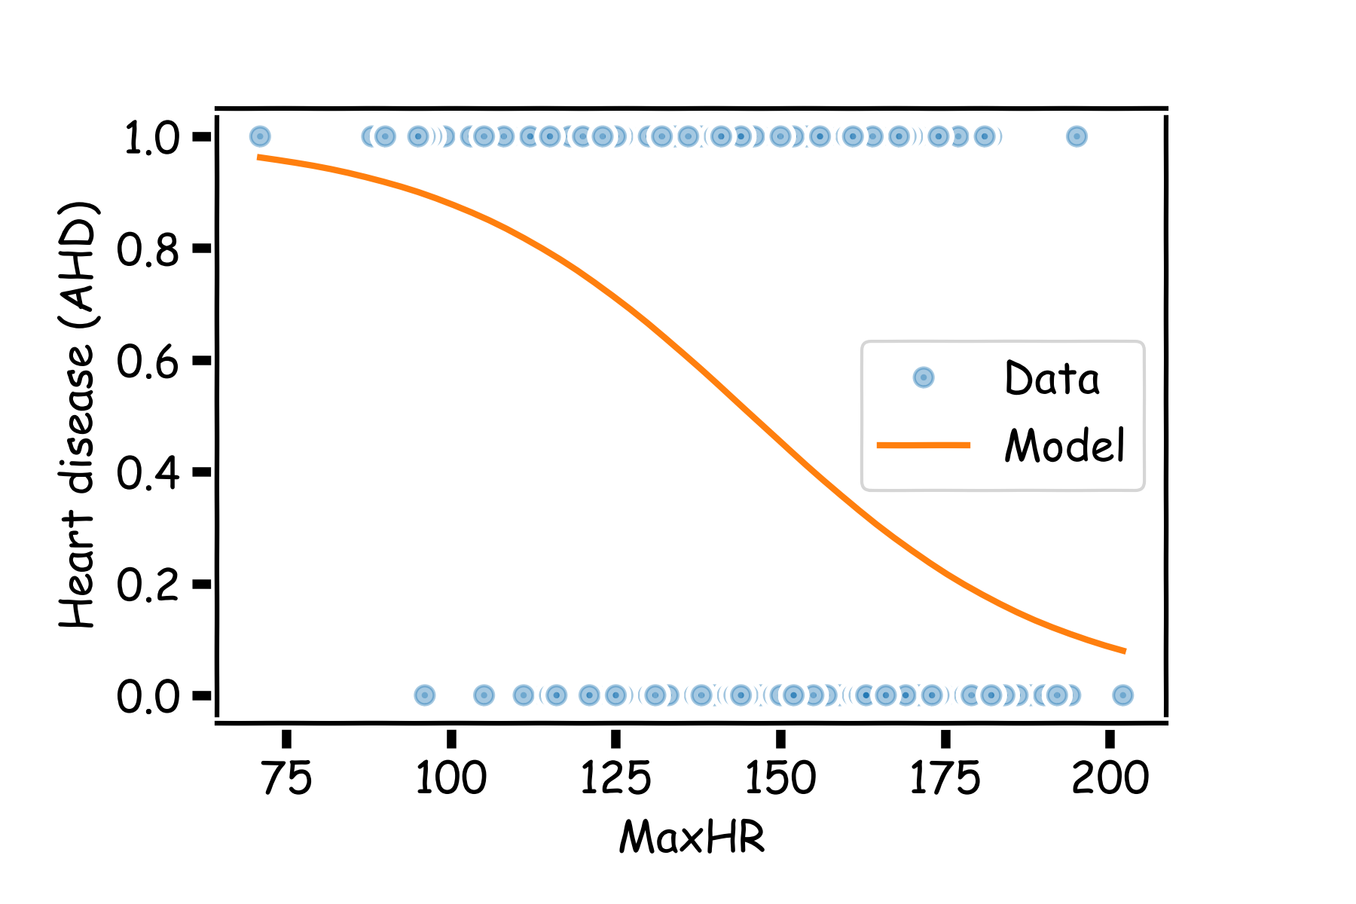
Heart Data: logistic estimation
$$β_{0}=6. 3, β_{1}=−0.043$$

Slide 50
Heart Data: logistic estimation
There are various ways to fit a logistic model to this data set in Python. The most straightforward in sklearn is via linear_model.LogisticRegression.

Slide 51
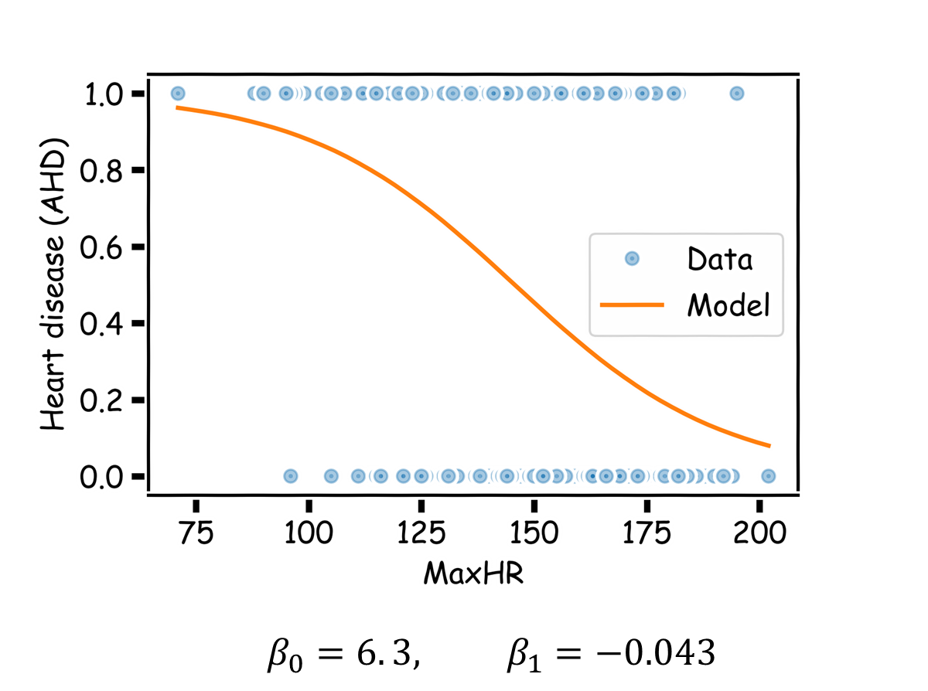
Heart Data: logistic estimation
Answer some questions:
Write down the logistic regression model.
Interpret ${\hat{β}}_{1}$.
Estimate the probability of heart disease for someone with MaxHR$≈$200?
If we were to use this model purely for classification, how would we do so?

Slide 52
Using Logistic Regression for Classification
How can we use a logistic regression model to perform classification?
That is, how can we predict when $Y=1$ vs. when $Y=0$?
We mentioned before, we can classify all observations for which $\hat{P}(Y=1)≥0.5$to be in the group associated with $Y=1$ and then classify all observations for which $\hat{P}\left(Y=0\right)<0.5$to be in the group associated with $Y=0.$
Assigns each observation to the most likely class, given its predictor values.

Slide 53
Please download and install the Slido app on all computers you use
Audience Q&A Session
ⓘ Start presenting to display the audience questions on this slide.

Slide 54
Lecture Outline
Classification: Categorical Response Variable
Binary Response and Simple Logistic Regression
Multiple Logistic Regression
Classification Boundaries
Multiple Responses and Multiclass Logistic Regression

Slide 55
Multiple Logistic Regression
It is simple to illustrate examples in logistic regression when there is just one predictor variable.
But the approach ‘easily’ generalizes to the situation where there are multiple predictors.
A lot of the same details as linear regression apply to logistic regression. Interactions can be considered. So is overfitting. Etc...
So how do we correct for such problems?
Regularization and checking through train, test, and cross-validation!
We will get into the details of this, along with other extensions of logistic regression

Slide 56
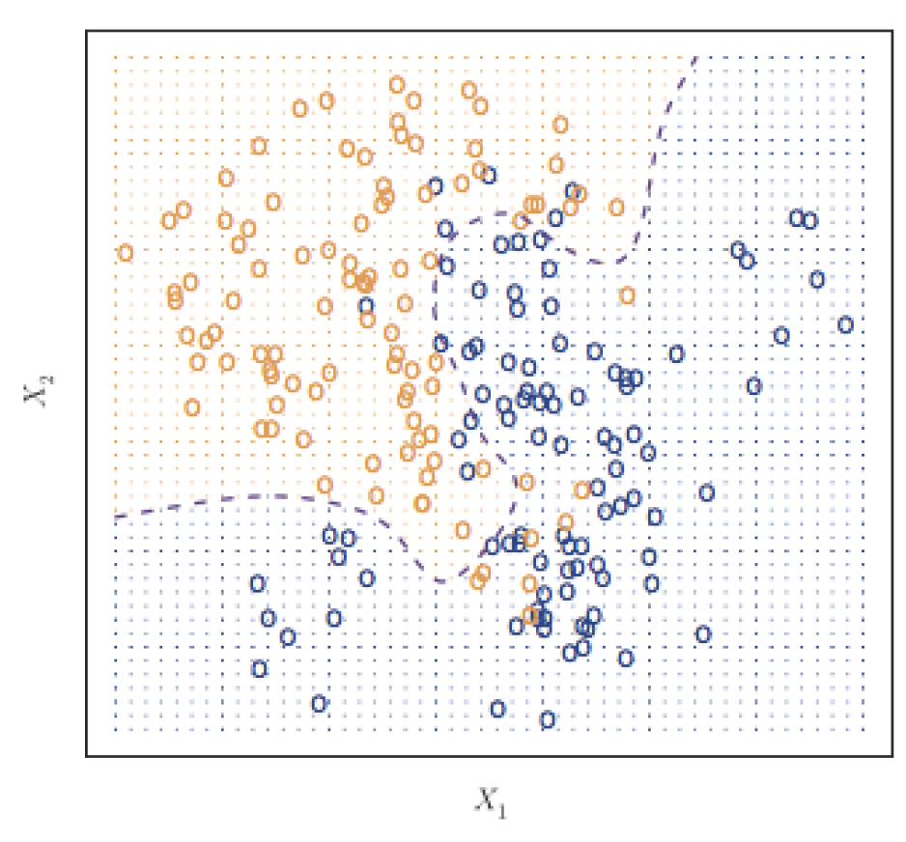
Classifier with two predictors
How can we estimate a classifier, based on logistic regression, for the following plot?

Slide 57
Multiple Logistic Regression
Earlier we saw the general form of simple logistic regression, meaning when there is just one predictor used in the model. What was the model statement (in terms of linear predictors)?
Multiple logistic regression is a generalization to multiple predictors. More specifically we can define a multiple logistic regression model to predict $P(Y=1)$ as such:

Slide 58
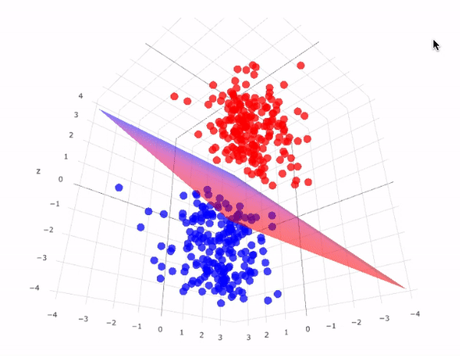
Multiple Logistic Regression

Slide 59
Fitting Multiple Logistic Regression
The estimation procedure is identical to that as before for simple logistic regression:
a likelihood approach is taken, and the function is maximized across all parameters $β_{0}$, $β_{1},…,β_{p}$ using an iterative method like gradient descent.
The actual fitting of a Multiple Logistic Regression is easy using software (of course there's a python package for that) as the iterative maximization of the likelihood has already been hard coded.
In the sklearn.linear_model package, you just have to create your multidimensional design matrix $X$ to be used as predictors in the LogisticRegression function.

Slide 60
Interpreting Multiple Logistic Regression: an Example
Let's get back to the Heart Data. We are attempting to predict whether someone has HD based on MaxHR and whether the person is female or male. The simultaneous effect of these two predictors can be brought into one model.
For single logistic regression, we have the following estimated models:
This “hat” notation means “our estimated value of”

Slide 61
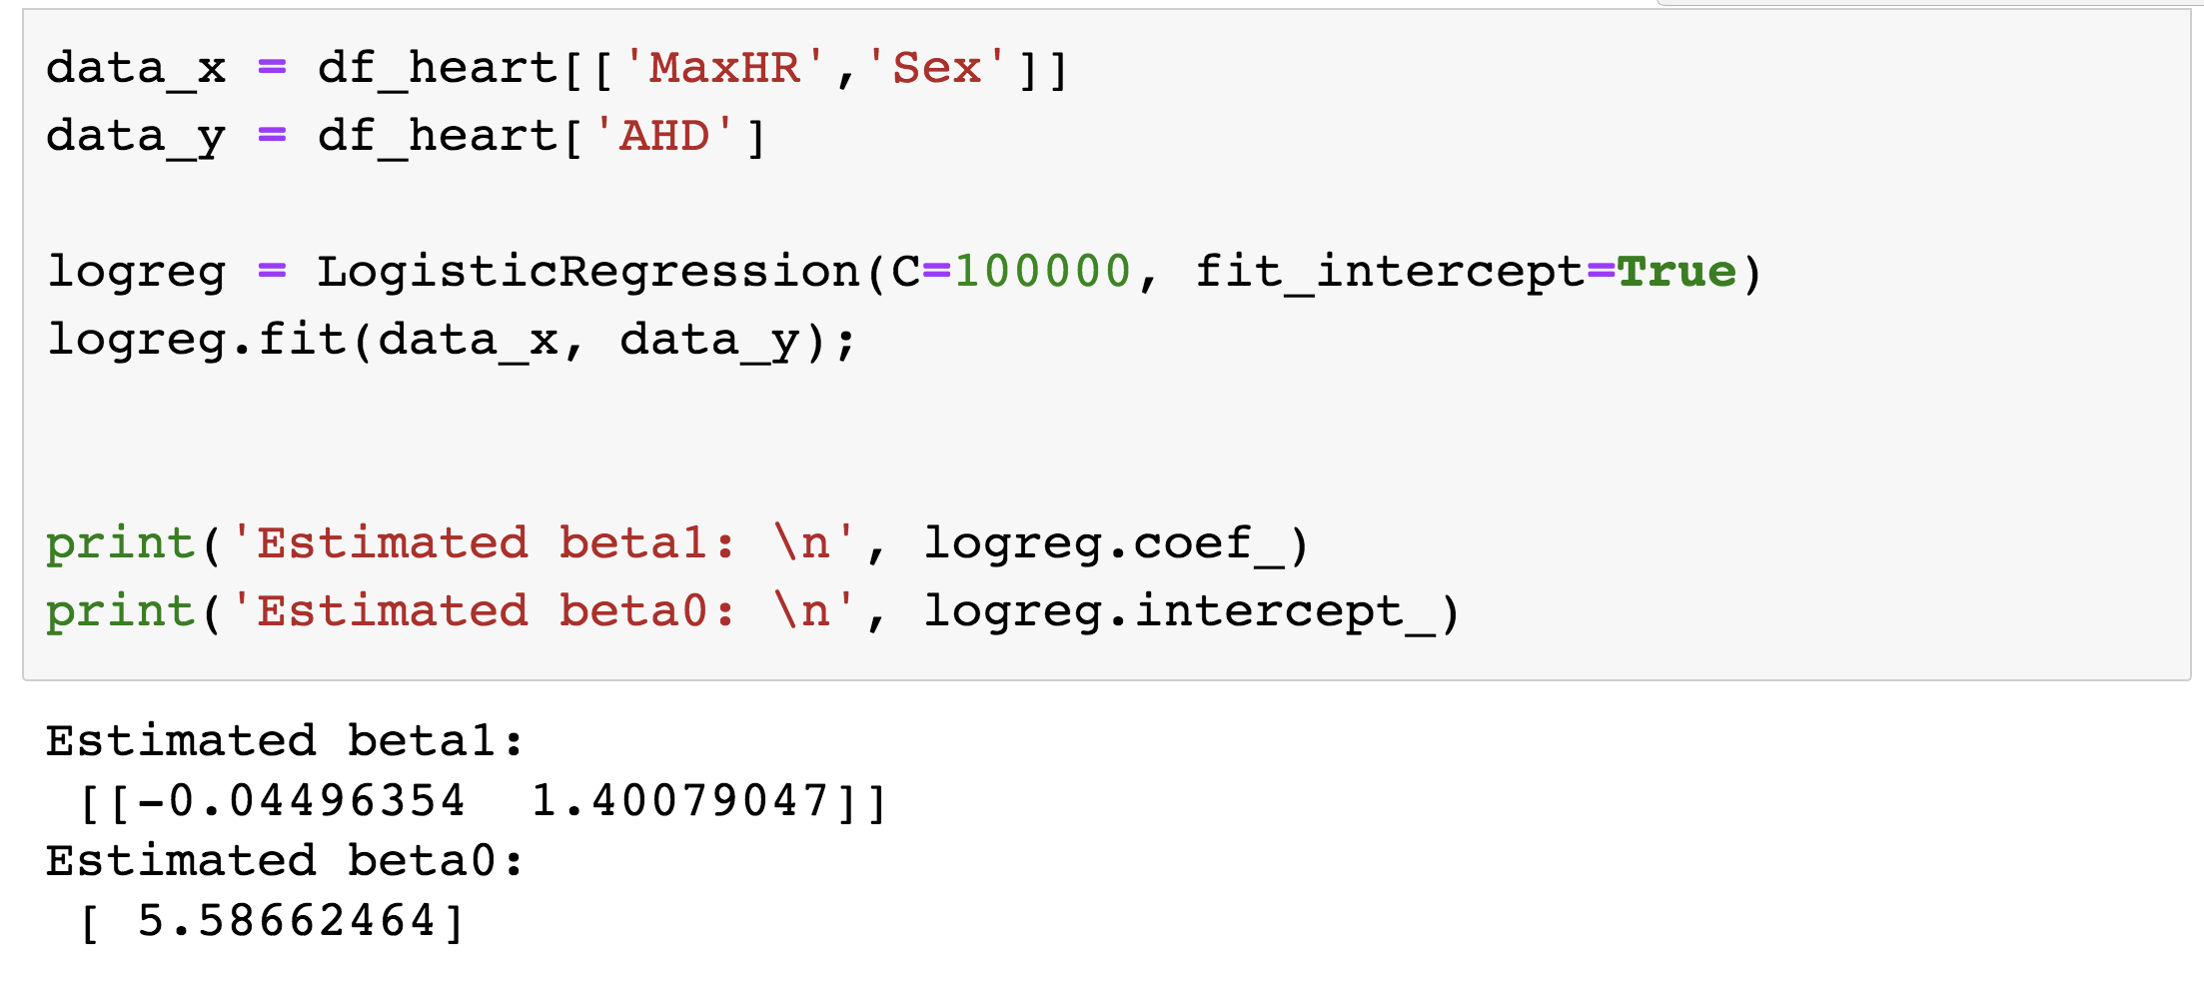
Interpreting Multiple Logistic Regression: an Example
The results for the multiple logistic regression model are:

Slide 62
Interactions in Multiple Logistic Regression
Just like in linear regression, interaction terms can be considered in logistic regression. An interaction terms is incorporated into the model the same way, and the interpretation is very similar (on the log-odds scale of the response of course).

Slide 63
Interpreting Multiple Logistic Regression: an Example
The results for the multiple logistic regression model are:

Slide 64
Please download and install the Slido app on all computers you use
Audience Q&A Session
ⓘ Start presenting to display the audience questions on this slide.

Slide 65
Content
Classification: Categorical Response Variable
Binary Response and Simple Logistic Regression
Multiple Logistic Regression
Classification Boundaries
Multiple Responses and Multiclass Logistic Regression

Slide 66
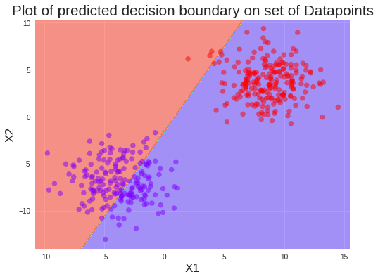
Classification boundaries
Recall that we could attempt to purely classify each observation based on whether the estimated $P(Y=1)$ from the model was greater than 0.5.
Decision boundary of Logistic regression is the set of all points 𝑥 that satisfy ℙ(𝑦=1|𝑥)=ℙ(𝑦=0|𝑥)=1/2.
When dealing with ‘well-separated’ data, logistic regression can work well in performing classification.
Notes:
Decision boundary of Logistic regression is the set of all points 𝑥x that satisfy ℙ(𝑦=1|𝑥)=ℙ(𝑦=0|𝑥)=1/2.
When x0+b1x1+b2x2>=0, p(Y=1|x)>=0.5, Y=1 otherwise p(Y=1|x)<=0.5, Y=0
Decision boundary: x0+b1x1+b2x2=0

Slide 67

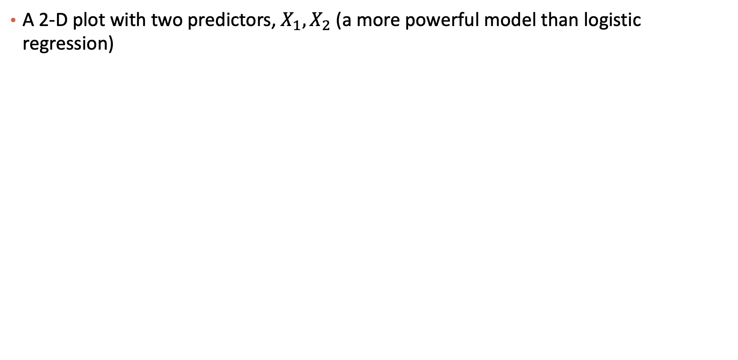
Classification boundaries
A 2-D plot with two predictors, $X_{1},X_{2}$ (a more powerful model than logistic regression)
Notes:
Decision boundary of Logistic regression is the set of all points 𝑥x that satisfy ℙ(𝑦=1|𝑥)=ℙ(𝑦=0|𝑥)=1/2.
When x0+b1x1+b2x2>=0, p(Y=1|x)>=0.5, Y=1 otherwise p(Y=1|x)<=0.5, Y=0
Decision boundary: x0+b1x1+b2x2=0

Slide 68
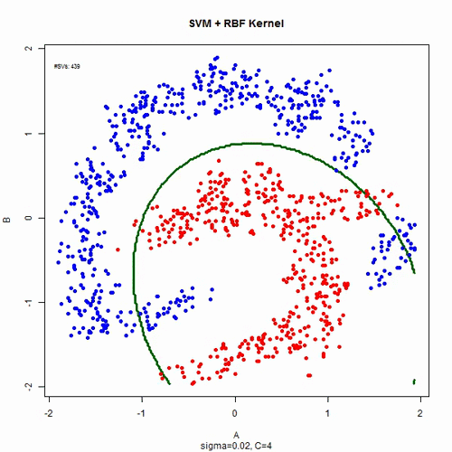
Classification boundaries

Slide 69
Exercise
Q: in the simple logistic regression case, what is the decision boundary?
Goal: want to find x such that P(Y=1|x) = 0.5,
=> $β_{0}+β_{1}x=0$ (e.g., $β_{0}$ = 4, $β_{1}$=8)
=>$x=−\frac{β_{0}}{β_{1}}(e.g., =−\frac{1}{2})$

Slide 70
Exercise
What would be the decision boundary when we have two predictors
Goal: want to find x such that P(Y=1|x) = 0.5,
=> $β_{0}+β_{1}x_{1}+β_{2}x_{2}=0$ ($say, β_{0}$ = 4, $β_{1}$=8, $β_{2}$=4)
=> $4+8x_{1}+4x_{2}=0$
=>x2 = -2x1-1
A function of a line

Slide 71
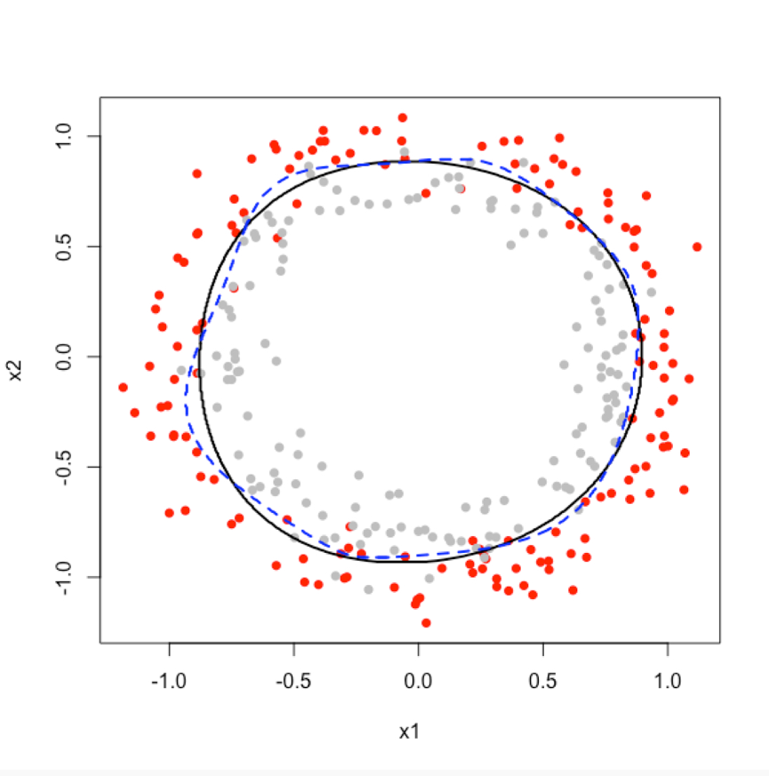
2D Classification in Logistic Regression: an Example
Question: how can we get such decision boundary (black one) using logistic regression?

Slide 72
Please download and install the Slido app on all computers you use
Audience Q&A Session
ⓘ Start presenting to display the audience questions on this slide.

Slide 73
Content
Classification: Categorical Response Variable
Binary Response and Simple Logistic Regression
Multiple Logistic Regression
Classification Boundaries
Multiple Responses and Multiclass Logistic Regression

Slide 74
Logistic Regression for predicting more than 2 Classes
Multinomial logistic regression.
An extensions to standard logistic regression when the response variable Y has more than 2 categories

Slide 75
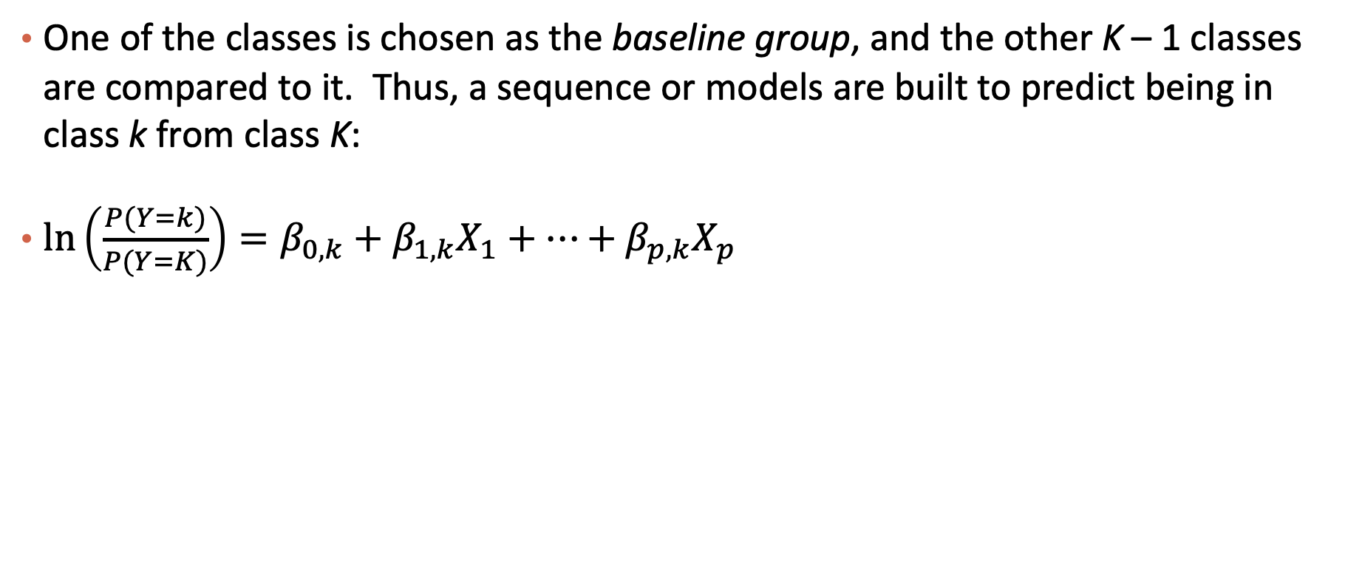
Multinomial Logistic Regression
One of the classes is chosen as the baseline group, and the other K – 1 classes are compared to it. Thus, a sequence or models are built to predict being in class k from class K:
$\ln\left(\frac{P(Y=k)}{P(Y=K)}\right)=β_{0,k}+β_{1,k}X_{1}+…+β_{p,k}X_{p}$
Notes:
https://en.wikipedia.org/wiki/Multinomial_logistic_regression
https://stats.stackexchange.com/questions/52104/multinomial-logistic-regression-vs-one-vs-rest-binary-logistic-regression

Slide 76
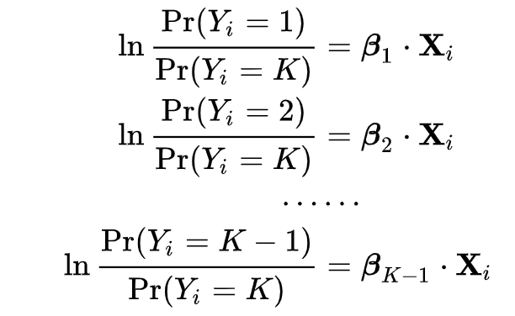
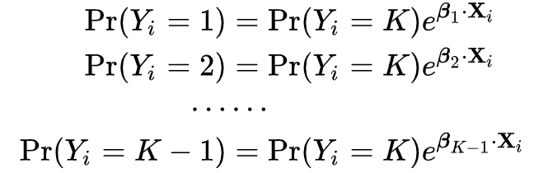
Multinomial Logistic Regression
If outcome K (the last outcome) is chosen as the pivot:
If we exponentiate both sides, and solve for the probabilities, we get:

Slide 77
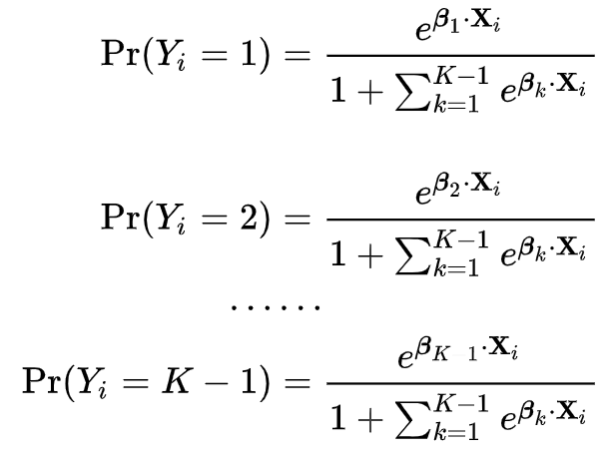
Multinomial Logistic Regression
Using the fact that all K of the probabilities must sum to one, we find:
We can use this to find the other probabilities:

Slide 78
Multinomial Logistic Regression in Python

Slide 79
Classification for more than 2 Categories
When there are more than 2 categories in the response variable, then there is no guarantee that P(Y = k) ≥ 0.5 for any one category. Therefore, any classifier based on logistic regression will instead have to select the group with the largest estimated probability.

Slide 80
Classification for more than 2 Categories in sklearn

Slide 81
Summary
Classification: Categorical Response Variable
Binary Response and Simple Logistic Regression
Multiple Logistic Regression
Classification Boundaries
Multiple Responses and Multiclass Logistic Regression

Slide 82
Please download and install the Slido app on all computers you use
Audience Q&A Session
ⓘ Start presenting to display the audience questions on this slide.

Slide 83
An Alternative View of the Objective Function
Cross entropy loss
Measure the difference from the predicted distribution (p) to the ground truth distribution (q)
Cross entropy f$rom q to p: H\left(q,p\right)=−\sum_{k}{q_{k}log⁡(p_{k})}$
In the classification setting
$q_{0}=1 and q_{1}=0, if y=0$; $q_{0}=0 and q_{1}=1, if y=1$
$p_{0}=\frac{1}{1+\exp\left\{x^{T}β\right\}} and p_{1}=\frac{\exp\left\{x^{T}β\right\}}{1+\exp\left\{x^{T}β\right\}}$

Slide 84
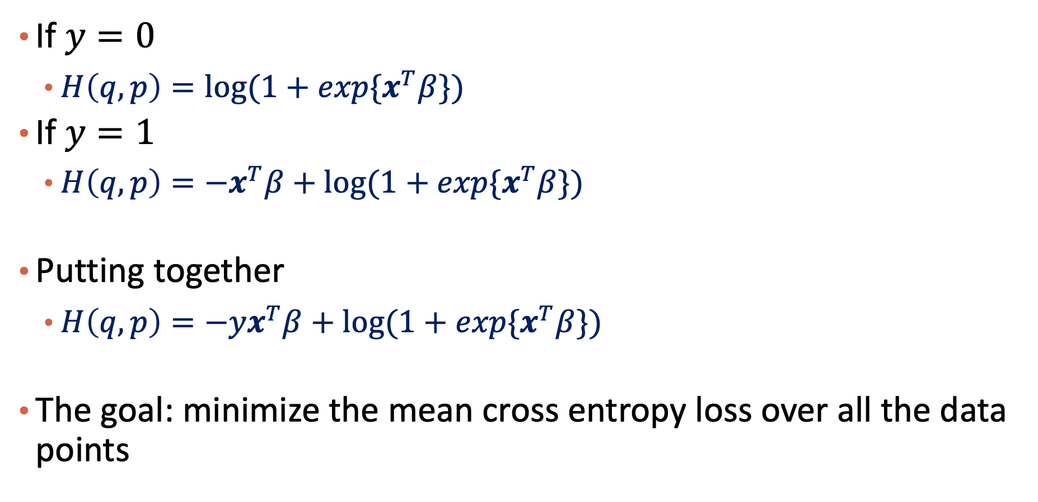
An Alternative View of the Objective Function (Cont.)
If $y=0$
$H\left(q,p\right)=log⁡(1+exp{\{x}^{T}β\})$
If $y=1$
$H\left(q,p\right)={−x}^{T}β+log⁡(1+exp{\{x}^{T}β\})$
Putting together
$H\left(q,p\right)={−yx}^{T}β+log⁡(1+exp{\{x}^{T}β\})$
The goal: minimize the mean cross entropy loss over all the data points

